Slide 1

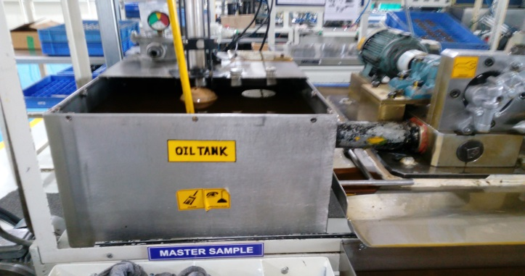
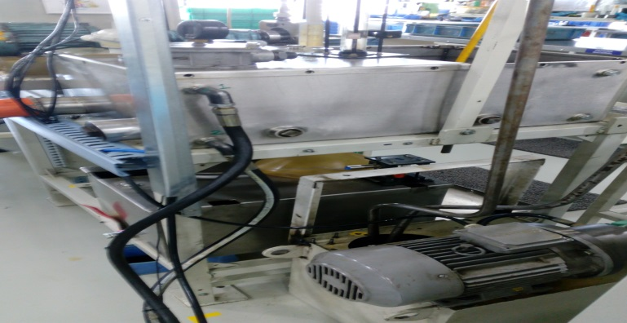
P15
TPM CIRCLE NO :-
ACTIVITY
KK
QM
PM
JH
SHE
OT
DM
E&T
KAIZEN IDEA SHEET
TPM CIRCLE NAME:
LOSS NO. / STEP
DEPT :- Assembly.
RESULT AREA
P
Q
A
C
D
S
M
CELL:-A225
CELL NAME:-Oil pump
MACHINE / STAGE :- A225 oil pump
OPERATION :- Flushing
KAIZEN THEME: To Increase Productivity
IDEA :To implement two different tank for inlet oil and outlet oil tank
Problem present status : oil Dirt earlier so changing oil continues .
COUNTERMEASURE: Inlet and outlet oil collect two different tank so that dirt oil collect separate tank
BENCHMARK
20 Sec
TARGET
14 Sec
KAIZEN START
10.10..2016
KAIZEN FINISH
28.12.2016
Inlet oil tank
TEAM MEMBERS: Monohar dore
BENEFITS :Save oil cost ,reduce operator
fatigue
Outlet oil tank
Before
After
KAIZEN SUSTENANCE
WHY - WHY ANALYSIS :-
1)Oil Change frequency more
2)Oil dirt earlier
3)Outlet oil collect same tank
4) Inlet oil store and outlet oil collect same tank
RESULT :-
Save oil cost
Reduce operator fatigue
WHAT TO DO:-
HOW TO DO:-
FREQUENCY :-
ROOT CAUSE: Inlet oil store and outlet oil collect same tank
REGISTRATION NO. & DATE:- 10.10.2016
SCOPE & PLAN FOR HORIZONTAL DEPLOYMENT
REGISTERED BY :- Manohar dore
SR.
NO.
CELL
TARGET
RESPONSIBILITY
STATUS
MANAGER’S SIGN :- Janardhan Sathe
1
M6 Tapping
30.10.16
Sujit
In process

